Slide 1



DASP 3.01
Improvements compared to DASP 2.3
By Araar Abdelkrim
Sunday, September 19, 2021
This work was carried out with financial and scientific support from the Partnership for Economic Policy (PEP), which is funded by the Government of Canada through the International Development Research Centre (IDRC) and Global Affairs Canada (GAC), and the William & Flora Hewlett Foundation. We are also grateful to the World Bank and UNDP that provided funds to develop the first version of DASP.
This work was carried out with financial and scientific support from the Partnership for Economic Policy (PEP), which is funded by the Government of Canada through the International Development Research Centre (IDRC) and Global Affairs Canada (GAC), and the William & Flora Hewlett Foundation. We are also grateful to the World Bank and UNDP that provided funds to develop the first version of DASP.

Slide 2
DASP 3.01, a NEW PEP realisation
Compared to DASP 2.3, the new version of DASP (DASP 3.01) includes many helpful improvements that can facilitate practitioners’ work when studying distributive analyses or program evaluations.
This work was financed by PEP, and I would like to thank the PEP network for supporting this project.
In what follows, we will introduce the improvements.

Slide 3
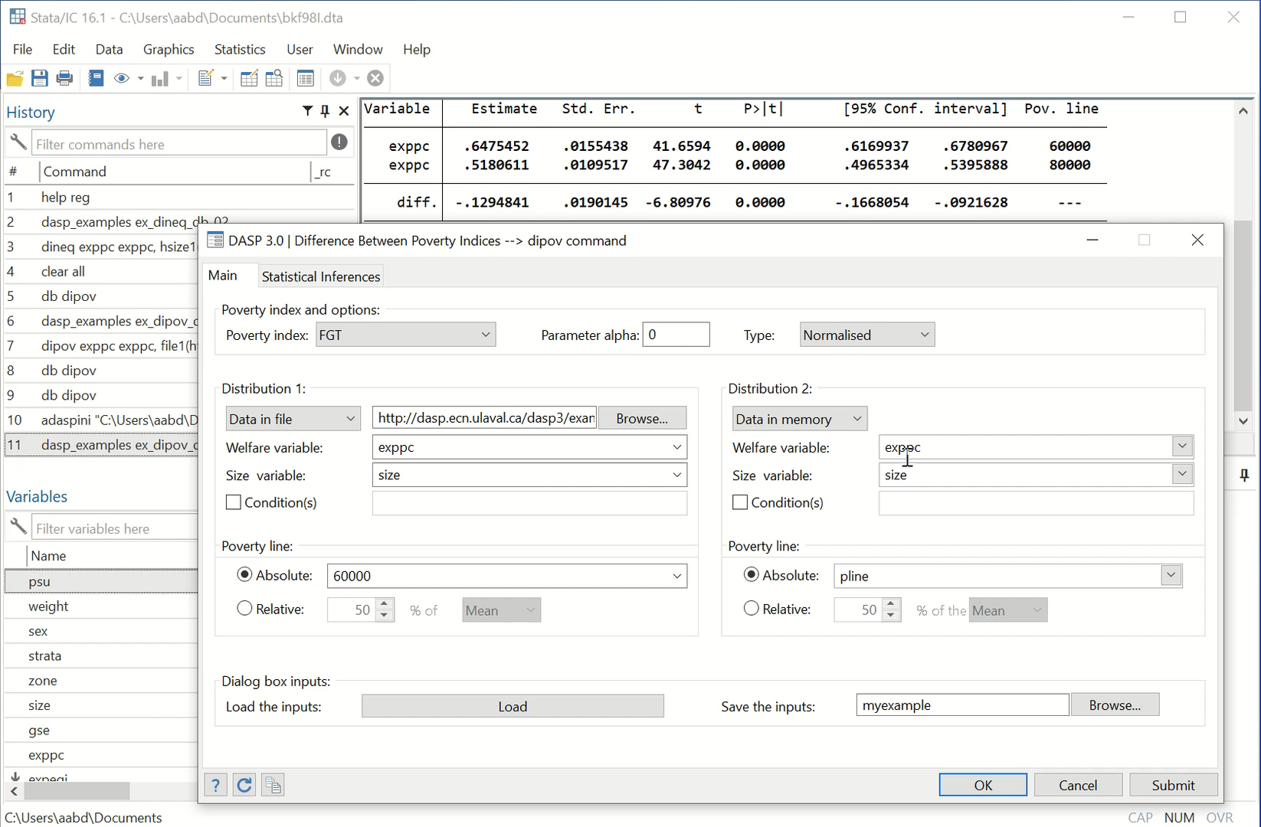
DIALOG BOXES
For most popular indices, the user can save dialog BD information and load it in another Stata session.
Video 1

Slide 4
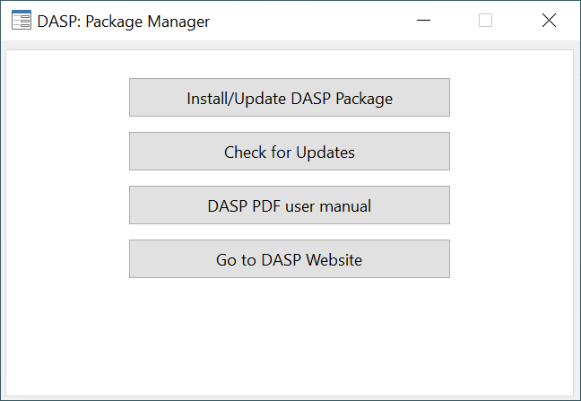
DIALOG BOXES
The new DASP Package Manager makes it easy to manage the package.

Slide 5
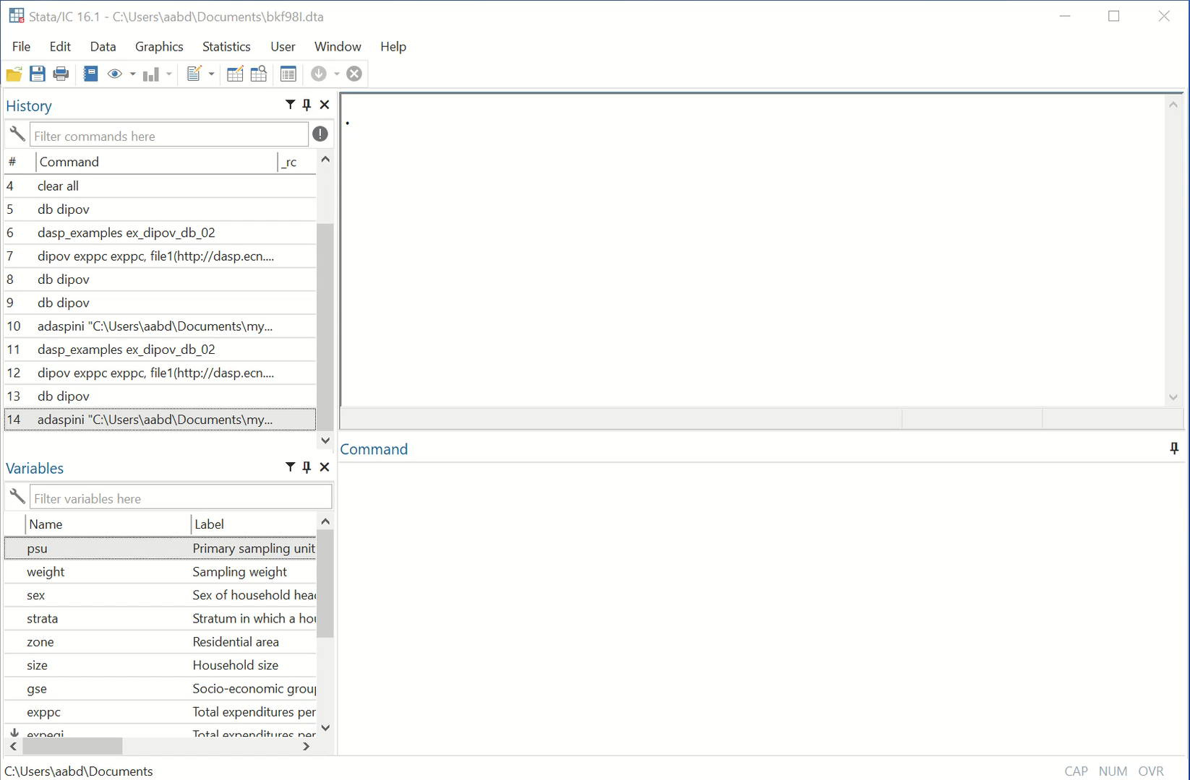
DIALOG BOXES
Now, lists of variables are automatically loaded when working with two distributions.
The user can indicate the poverty line as a numerical value or a variable.
Video 2

Slide 6
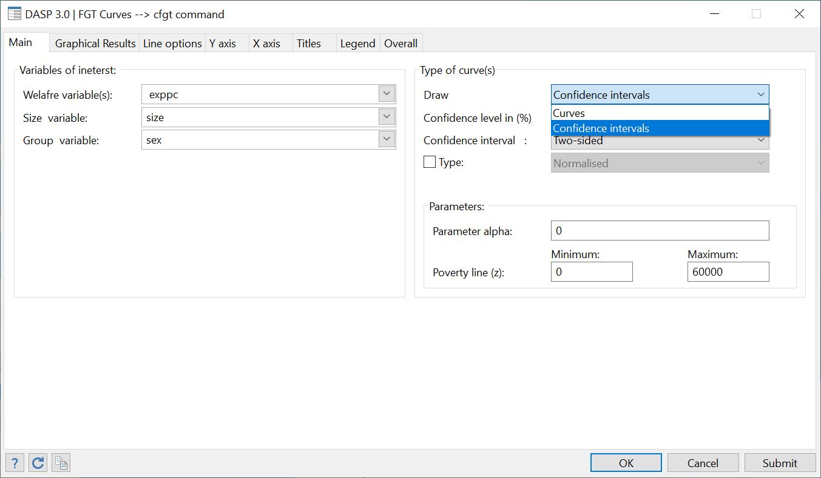
CURVES
All of the DASP curves have been improved.
Also, the user can display the confidence interval for many DASP curves.

Slide 7
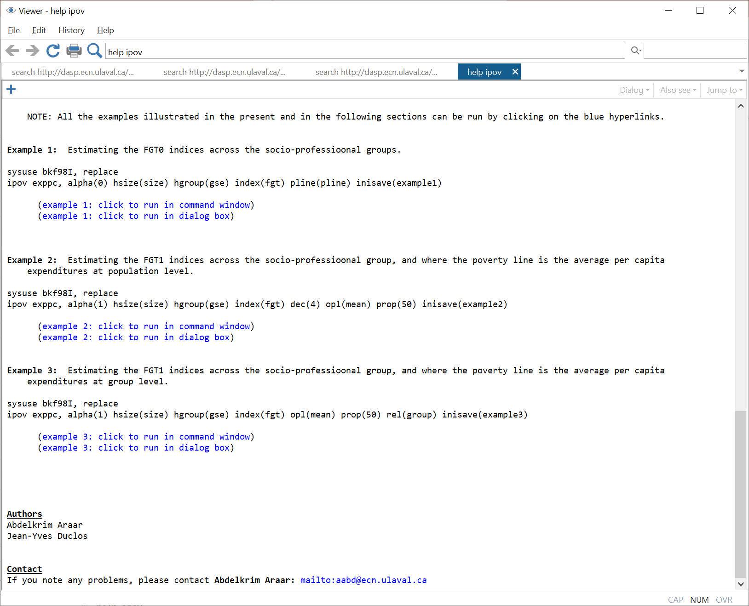
HELP
For the most popular modules, dynamic (click and watch) examples were added in the help files. This will make it easier to practice and become familiar with the DASP package.
The user can open the data files of the different examples included in the help files using the sysuse command.

Slide 8
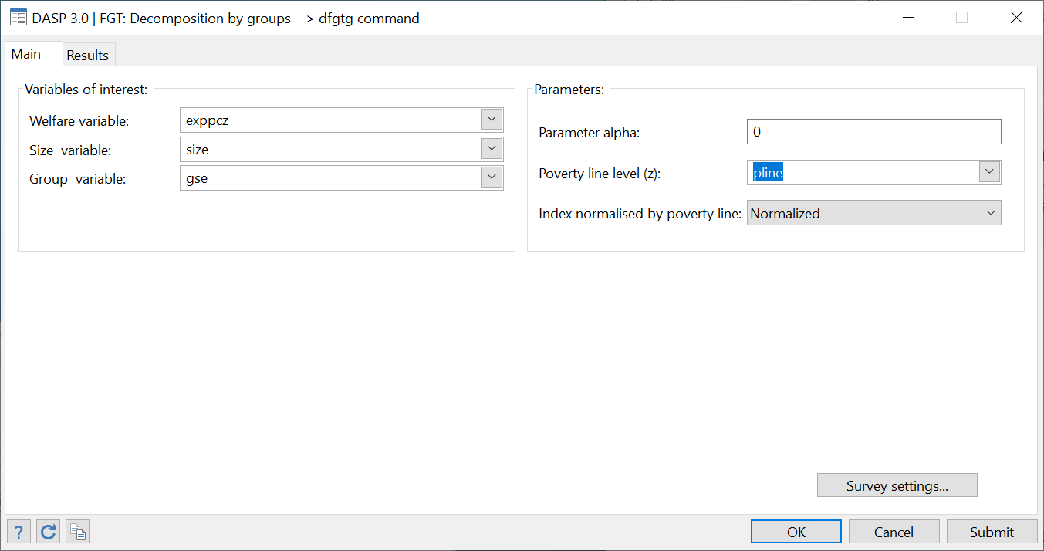
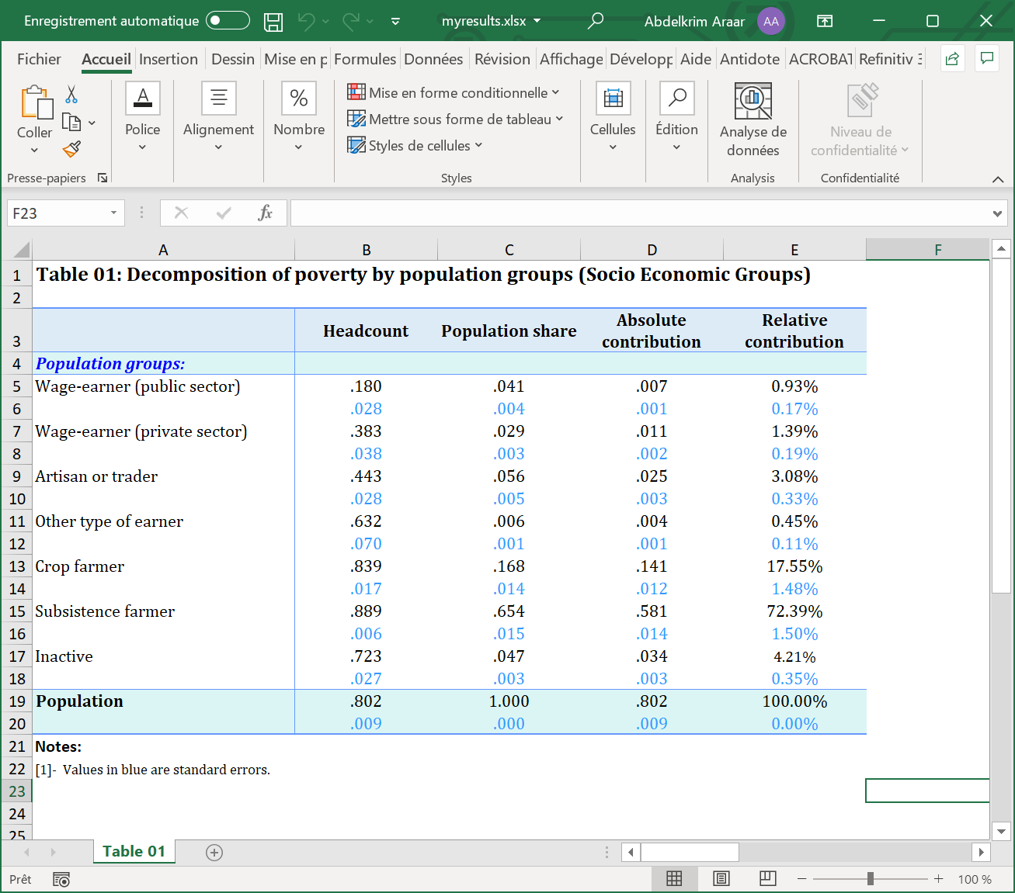
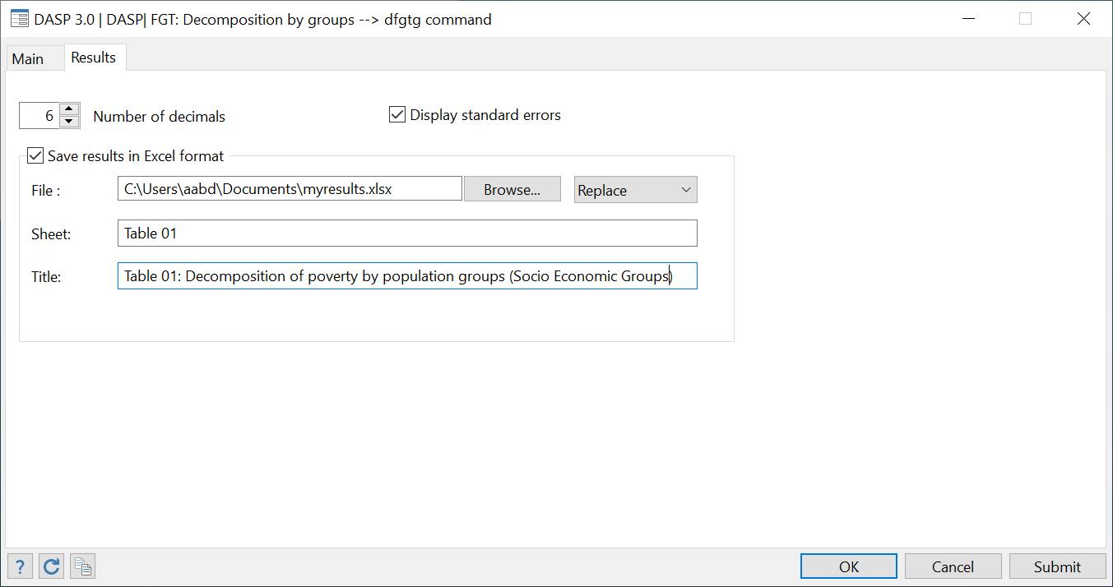
SAVING RESULTS IN EXCEL FORMAT
For a set of modules with long results, the user can save these results in an Excel file (remember, the old format was *.xml).

Slide 9
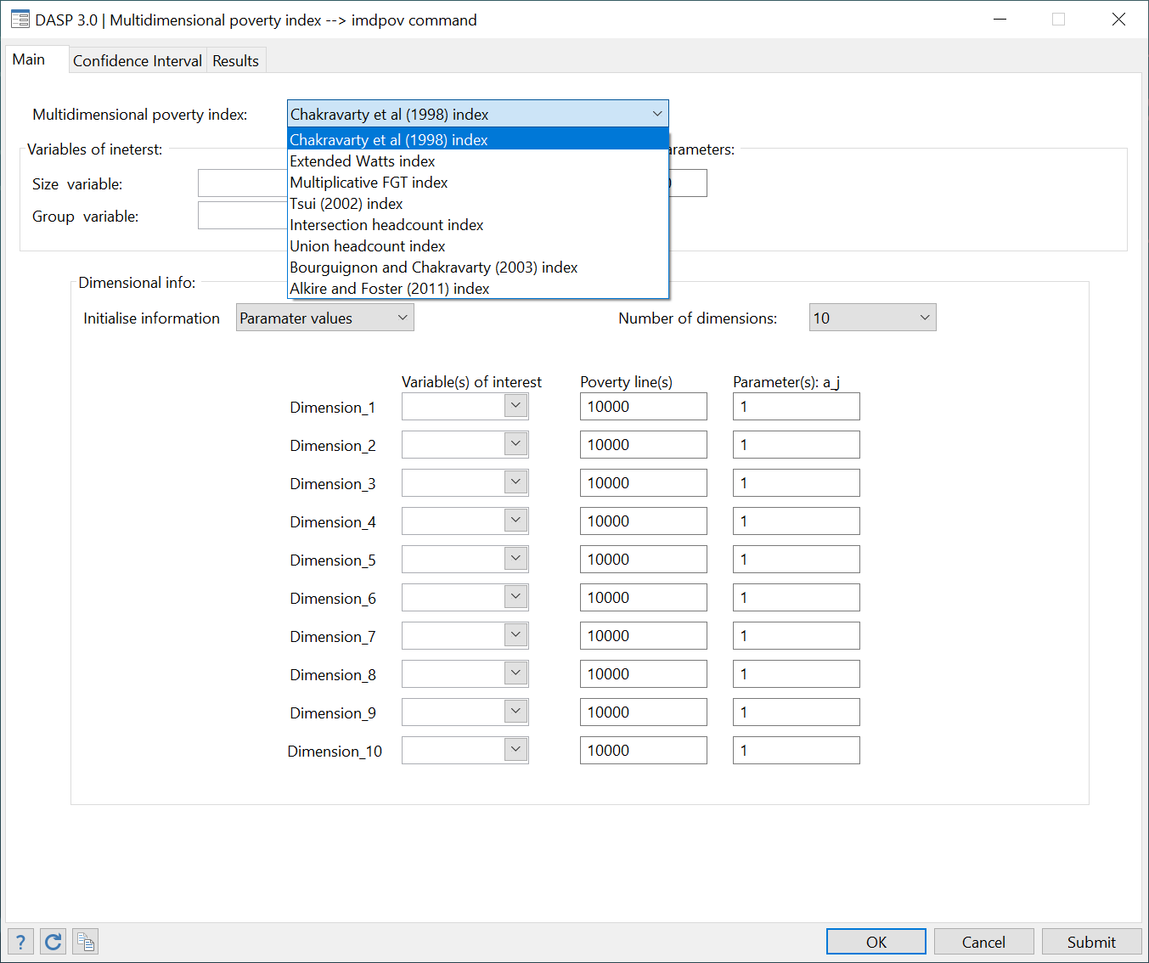
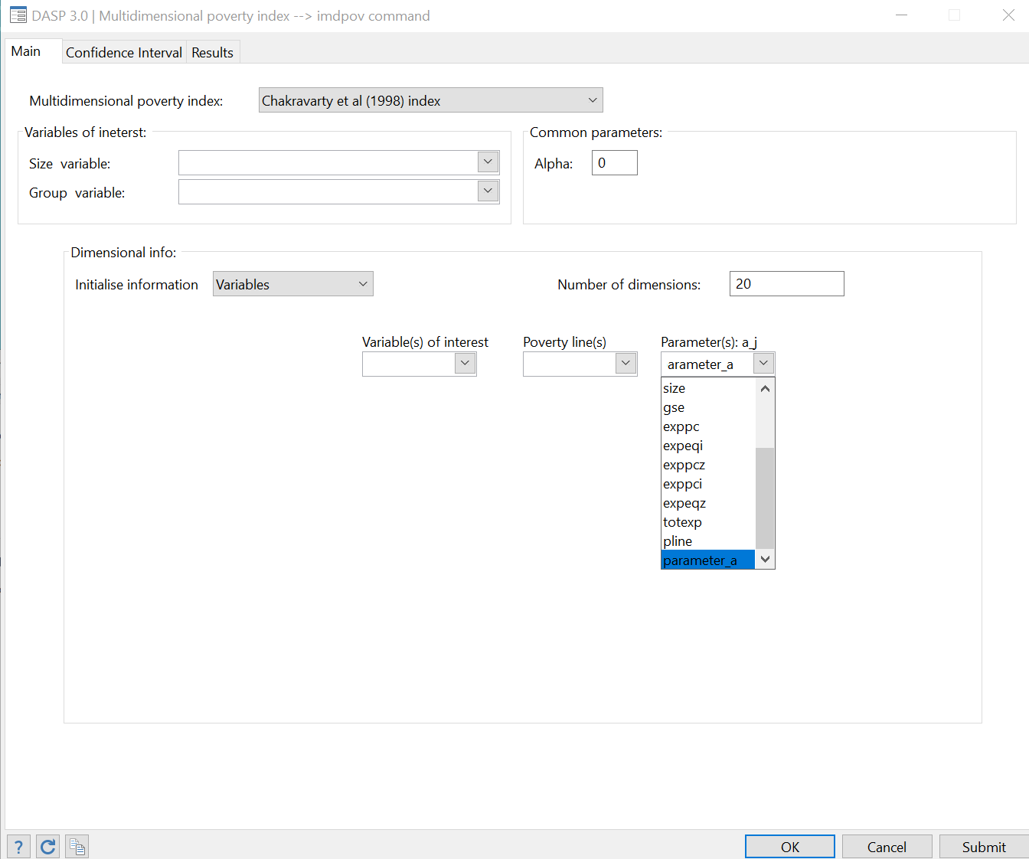
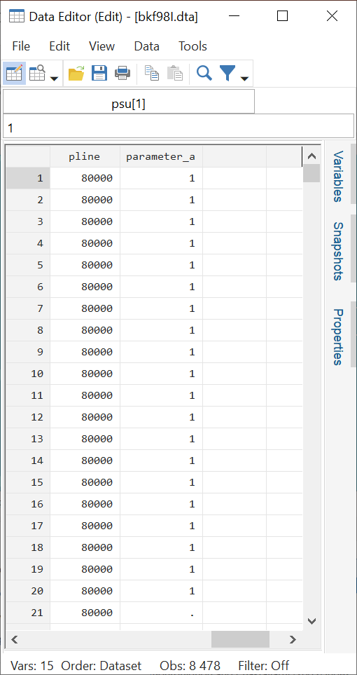
MULTIDIMENIONAL POVERTY
The user can select up to 10 dimensions for all multidimensional poverty indices.
Otherwise, the user can set the parameter values as variables and then estimate for any number of dimensions.

Slide 10
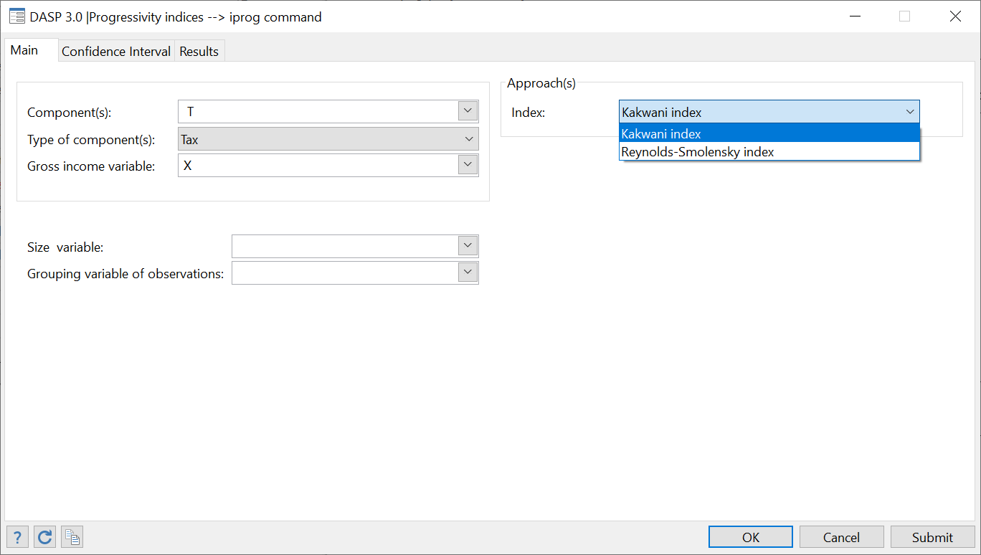
NEW MODULES
Progressivity indices (iprog)

Slide 11
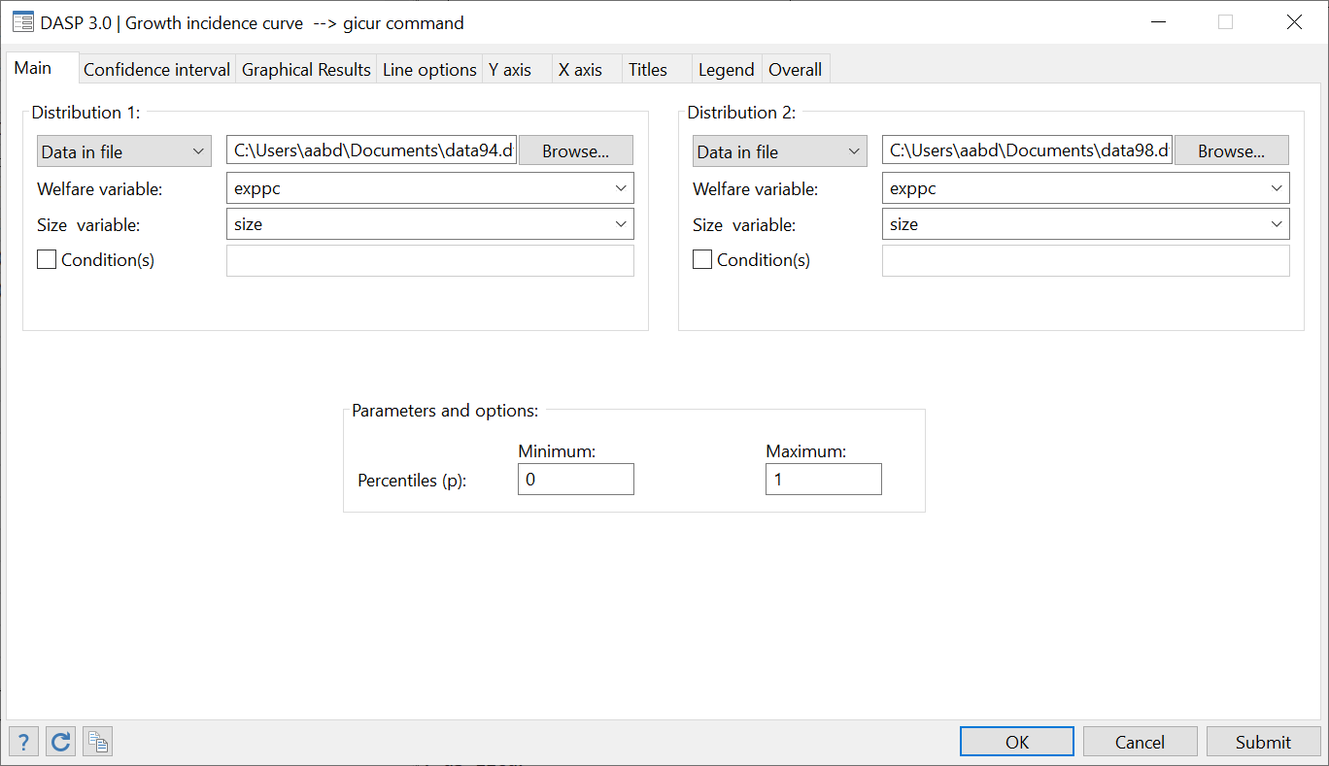
NEW MODULES
Growth incidence curve (gicur)

Slide 12
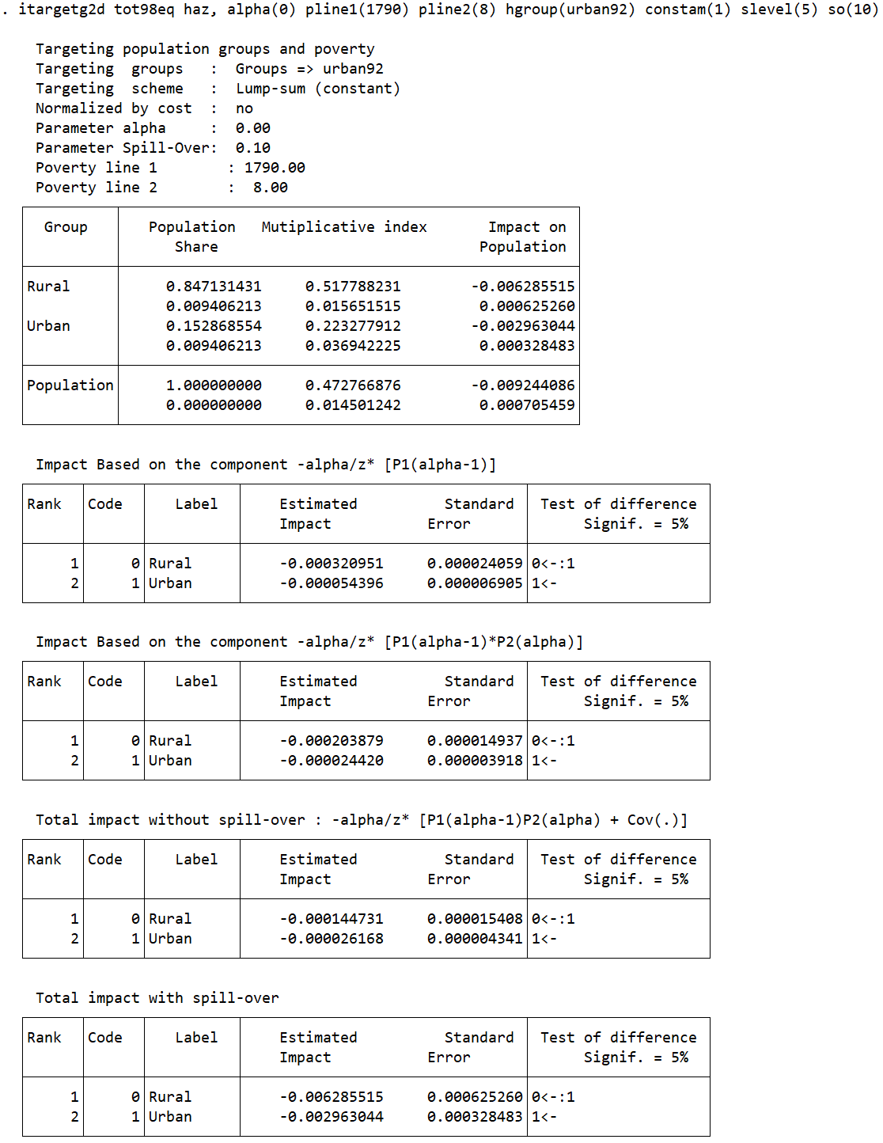
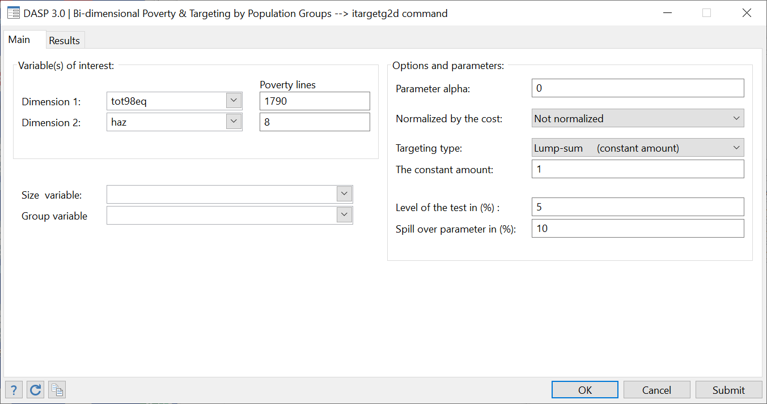
NEW MODULES
Bi-dimensional poverty targeting by population group (itargetg2d)

Slide 13
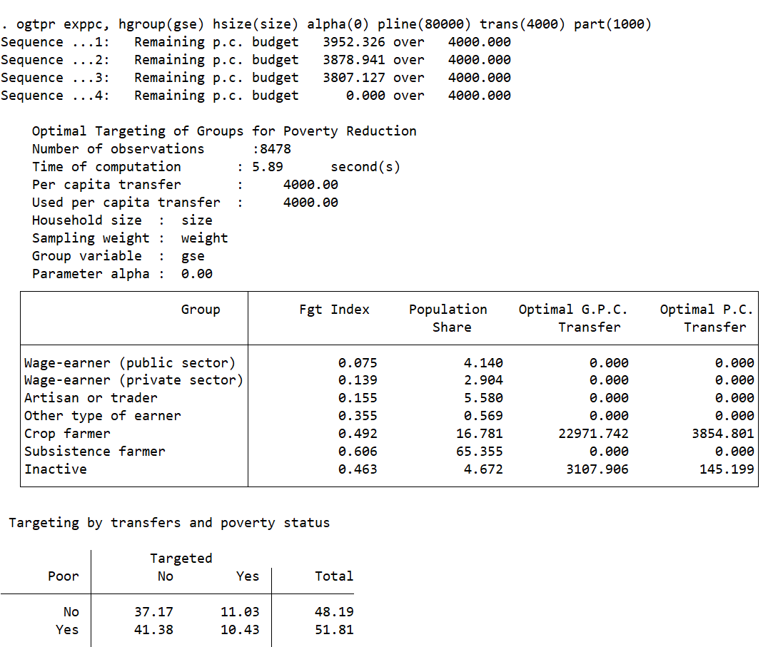
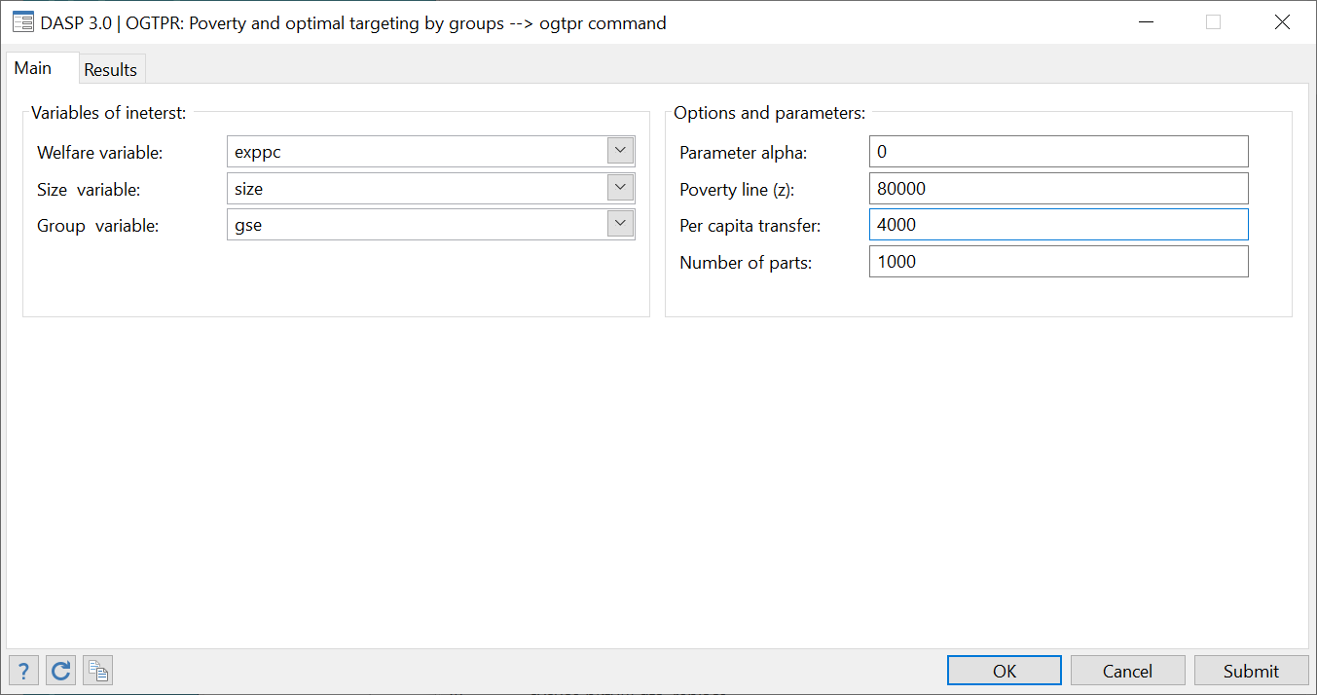
NEW MODULES
Optimal population group targeting with a fixed budget (ogtpr)

Slide 14
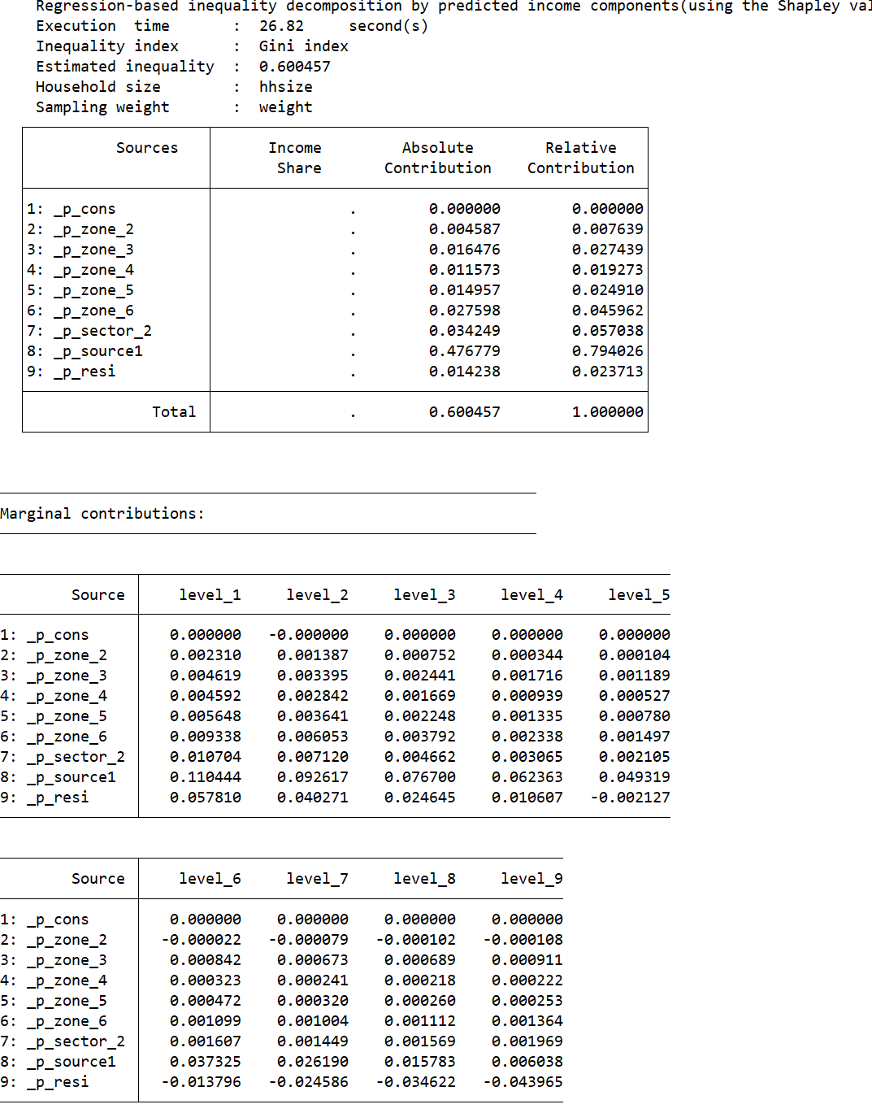
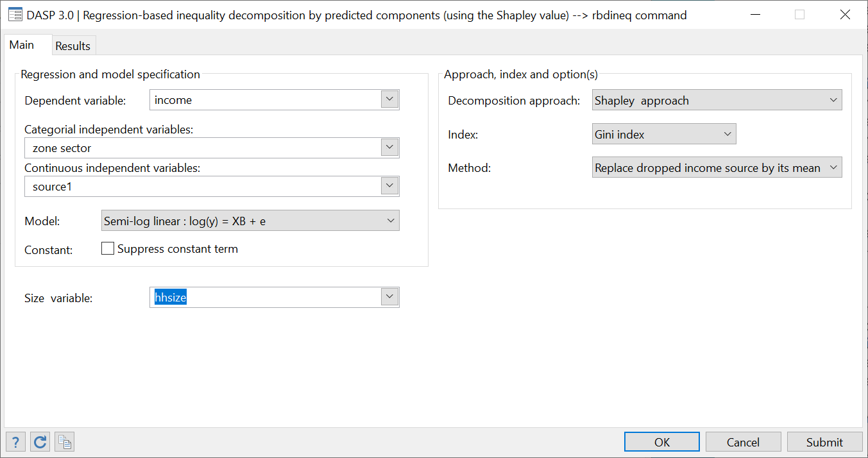
SOME IMPROVED MODULES
Regression-based inequality decomposion (rbdineq): Now the user can indicate the categorial independent variables separately.

Slide 15
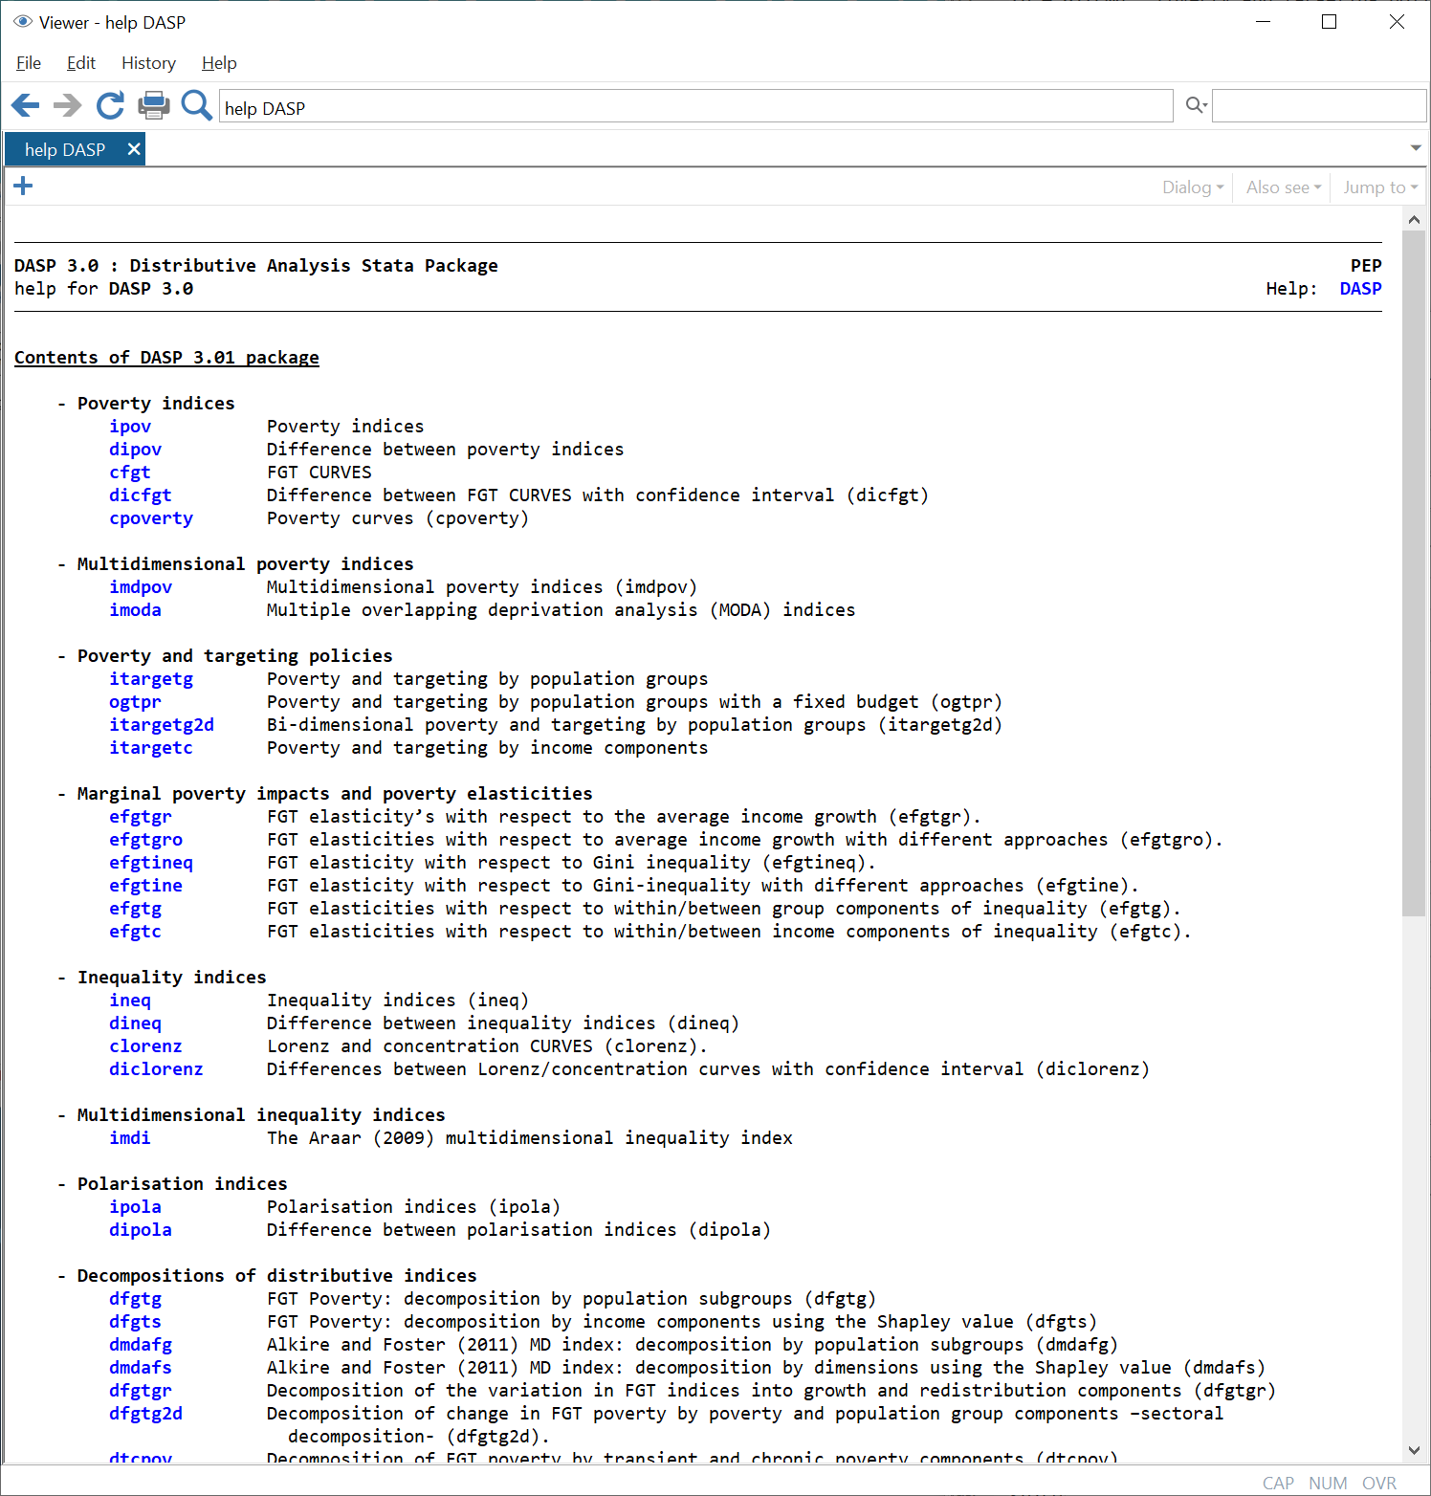
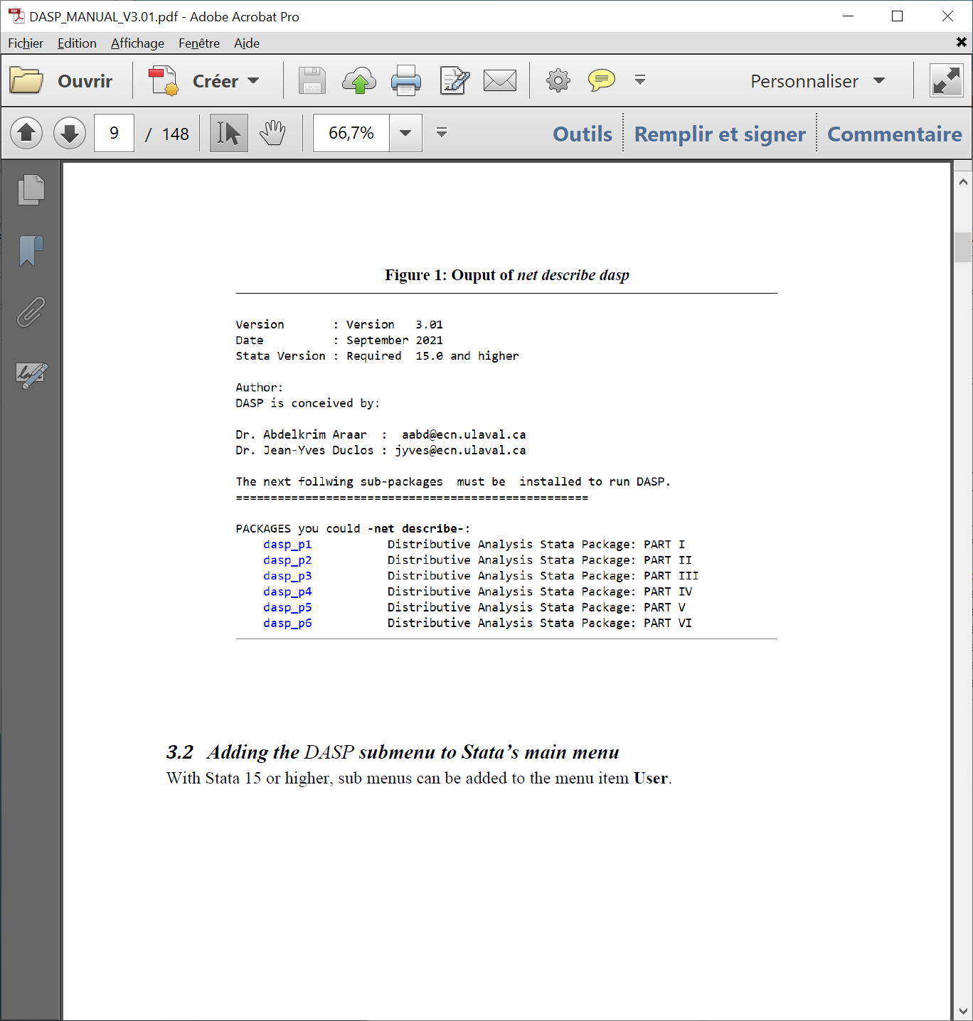
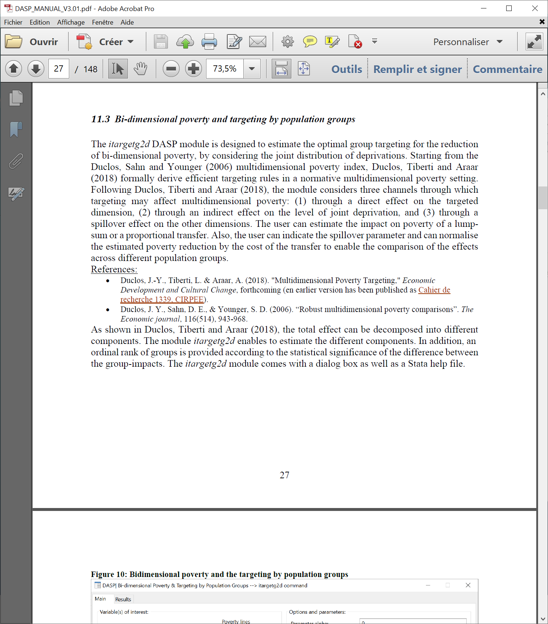
UPDATED USER MANUAL

